Slide 1


BUSINESS
COVER PAGE
ORACLE

Slide 2
Basic select statement
ORACLE is a relational database product which is used to store data permanently in secondary storage devices.
select *|{[distinct] column|expression [alias],....n}
from tablename
where cond
group by col_list
having cond
order by col_list [asc|desc]

Slide 3
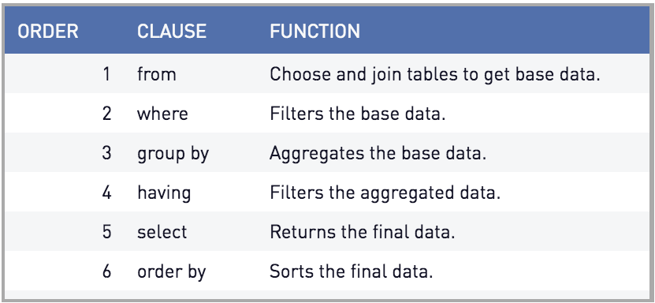
Defining SQL order of execution

Slide 4
Basic select statement
selecting all columns
select specific columns
Defining a null value
Null values in arithmetic expression
NVL() function
---------------
nvl(expr1,expr2)
Write a query to display ename,sal,comm,grosssal of employee smith fro m employee table.

Slide 5
Basic select statement
Defining a column alias
Concatenation operator
Eliminating Duplicate rows
Write a query to display 1st row from emp table using rowid.
Write a query to display last row from emp table using rowid.

Slide 6
Creating Duplicate Table From Existing Table [duplicate]
1.create a copy of an Oracle table without copying the data?
2. create full copy of existing table in oracle

Slide 7
operator used in select statement
Arithmetic operator.
1.Write a query to display
ename,sal,annsal from emp table.
2.Write a query to display the employees
who are getting morethan 30000 annual
salaries from emp table.

Slide 8
operator used in select statement
Relational operator
-------------------
Write a query to display the employees except job as clerk from emp table.
Write a query to display the employees who are getting more than 2000 salary from emp table.

Slide 9
operator used in select statement
Logical operator
----------------
Write a query to display those clerks having more than 1500 salary from employee table.
Write a query to display whose jobs are clerk either employee is getting more than 1500 salary from employee table.
Write a query to display the employees who are belongs to the dept numbers 10 and 30.

Slide 10
operator used in select statement
Special operator
----------------
in
not in
Write a query to display the employees who are
belongs to the dept numbers 10 and 30.

Slide 11
operator used in select statement
between
not between
is null
is not null
Write a query to display the employees
who are not getting comm from emp table
Write a query to display the employees
who are getting comm from emp table

Slide 12
operator used in select statement
like
not like
Write a query to display the employees whose ename
start with 'M' from emp table using like operator
Write a query to display the employees where ename
2nd will be 'L' from emp table using like operator

Slide 13
operator used in select statement
Write a query to display the employees who are joining in the month dec from emp table using like operator
Write a query to display the employees who are joining in the year 81 from emp table using like operator
Write a query to display the employees whose ename start with 's_' from emp table using like operator

Slide 14
Rules of Precedence:
Order Evaluated Operator
1 Arithmetic operators
2 Concatenation operator
3 Comparison conditions
4 Is[not]null,like,[not]in
5 [not]between
6 Not logical condition
7 And logical condition
8 Or logical condition

Slide 15
Character Strings and Dates
Character Strings and Dates values are enclosed in single
quotation marks.
Character values are case sensitive and date values are format
sensitive.
Default date format is DD-MON-RR OR DD-MON-YY

Slide 16
Order By Clause
ASC:ascending order,
Default(ASC)
DESC: descending order

Slide 17
The Order by clause comes last in the select statement.
Ex:
Select ename,job,deptno,hiredate
from emp
order by hiredate;

Slide 18
Sorting in Descending order
Ex:
Select ename,job,deptno,hiredate
from emp
order by hiredate desc;

Slide 19
- Sorting by column Alias
Ex:
Select empno,ename,salary*12 annsal
from emp
order by annsal;

Slide 20
- Sorting by Multiple columns
Ex:
Select ename,deptno,salary
from emp
order by deptno,salary Desc;

Slide 21
THANK YOU

